Slide 1
GCOR XIV Advertising PLAN
MAY 2020

Slide 2
Introduction
All the proposed strategies, plans, and budgets are all part of a Phase 1 rollout to get a baseline for measuring how each of the ads perform
After monitoring the analytics and data that comes from each ad in each campaign, we will see what works and what doesn’t work
Then we will adjust the ad accordingly (copy, graphics, target audience, budget, etc.) on the fly while it is still live and active

Slide 3
GCOR XIV
Goals:
Increase awareness
Drive registrations
Generate 5% more registrations than GCOR XIII
Strategy:
Focus on LinkedIn Ads
Single Image
LinkedIn ads allows us to hyper-focus on industry and audience
Run a combination of above ads for 45 days and course correct as we see fit

Slide 4
GCOR XIV
Single Image Ad:
Objective: Website Visits
Region: United States
Forecasted Target Audience Size: 350,000+
Forecasted Total Impressions: 74,000 – 300,000
Forecasted CTR: 0.36% - 0.53%
Forecasted Total Clicks: 470 - 1000
Conversion Tracking: GCOR Virtual Microsite
Job Titles: Operational Risk Manager, Operational Risk Specialist, Head Of Operational Risk, Head Of Market Risk, Head Of Internal Audit, Risk Management Specialist, Chief Compliance Officer, Vice President Compliance, Chief Risk Officer, Director of Risk Management, Vice President of Risk Management, Enterprise Risk Manager, Manager Enterprise Risk Services, Head Of Risk Management, Senior Risk Manager, Head Of Risk, Internal Auditor, Senior Internal Auditor, Senior Auditor, Audit Internal, Audit Manager, Director Of Internal Audit, Legal Counsel, Senior Legal Counsel, Corporate Legal Counsel, Chief Legal Counsel, Assistant Legal Counsel, Compliance Manager, Compliance Officer, Senior Compliance Manager, Business Continuity Specialist, Business Continuity Manager, Business Continuity Consultant, Business Continuity Analyst, Business Continuity Coordinator

Slide 5
Target audience
Bank Size
Discipline
Job Experience Level
Job Role
Market Risk
Primary:
Mid-level
Senior
Primary:
Operational Risk Manager
Internal Audit
Head of Market Risk
Risk Management Specialist
Chief Compliance Officer
Enterprise Risk Manager
Internal Auditor
Legal Counsel
Third Party Risk Manager
Business Continuity Planning Manager
Compliance
Enterprise Risk
Legal
Multi-National
National
Regional
Regional Community
Regional Community
Community
Local Community

Slide 6
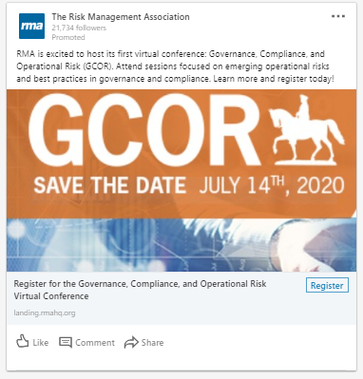
GCOR XIV LinkedIn ad examples
Single Image Ad

Slide 7
Proposed Budget
Single Image Ad: ≈ $40 / day (Run for 40 Days = $1600)

Slide 8
Questions?

