Slide 1
GCOR XIV and RMA Products Paid Ads
June 2020

Slide 2
GCOR XIV
Publish Date: 6/2/2020
Impressions: 65,504 Users (Views)
Clicks: 203 Users (Clicks)
Conversions: TBD - Waiting on Personify Tracking Link
Average CPC: $4.24
Spend: $851.15
Budget: $40 / day (Run for 40 Days = $1600)

Slide 3
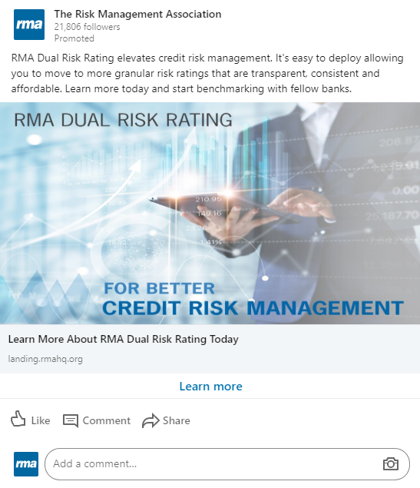
Dual risk rating lead generation Ad
Publish Date: 6/9/2020
Impressions: 5,797 Users (Views)
Clicks: 40 Users (Clicks)
Conversions: 10 Leads (Filled out Form)
Average CPC: $9.91
Spend: $419.85
Budget: $30 / day (Run for 90 Days = $2700)

Slide 4
Model validation consortium lead generation AD
Publish Date: 6/9/2020
Impressions: 6,247 Users (Views)
Clicks: 56 Users (Clicks)
Conversions: 6 Leads (Filled out Form)
Average CPC: $7.69
Spend: $420.11
Budget: $30 / day (Run for 90 Days = $2700)

Slide 5
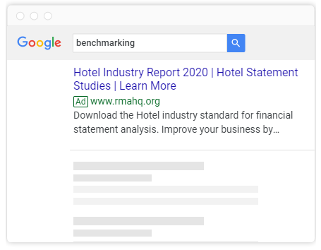
Upcoming ads
1. Annual Statement Studies Individual Download Google Dynamic Text Ad
Launching: 6/29/20
2. Model Validation Consortium Google Text Ad
Launching: 6/29/20
3. Dual Risk Rating Conversation Ad
Launching: 9/21/20

