Slide 1
RMA Products Advertising PLANs
MAY 2020

Slide 2
Introduction
All the proposed strategies, plans, and budgets are all part of a Phase 1 rollout to get a baseline for measuring how each of the ads perform
After monitoring the analytics and data that comes from each ad in each campaign, we will see what works and what doesn’t work
Then we will adjust the ad accordingly (copy, graphics, target audience, budget, etc.) on the fly while it is still live and active

Slide 3
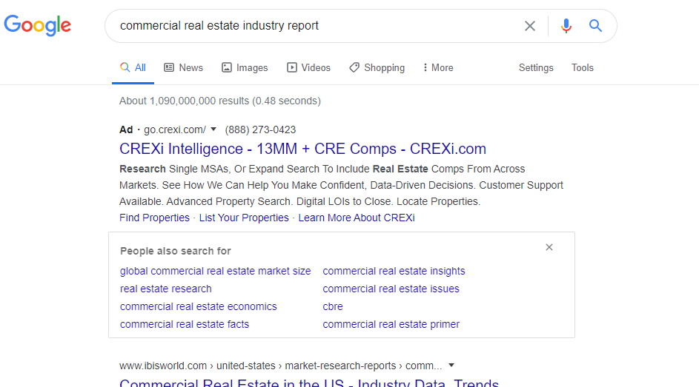
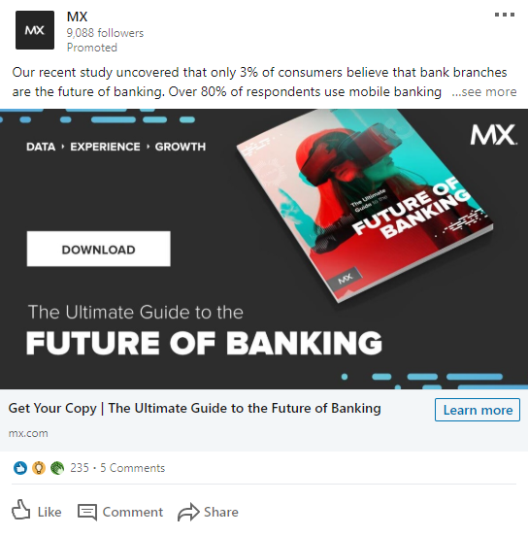
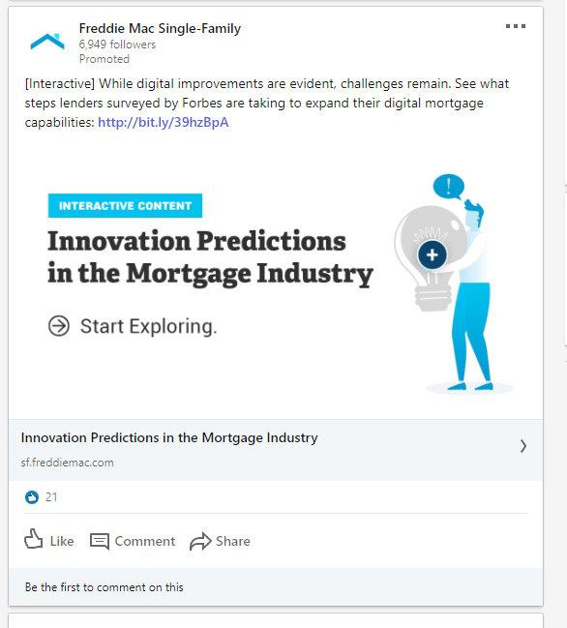
Competitor research

Slide 4
RMA Products
Dual Risk Rating
Model Validation Consortium
Statement Studies (Individual Downloads)

Slide 5
Dual risk rating

Slide 6
Dual risk rating
Goals:
  Increase awareness
  Generate inquiries
  Convert inquiries to leads
  Generate 10 new leads a month over 90 days
Strategy:
  Focus on LinkedIn Ads
    Single Image
    Video
    Conversation
  LinkedIn ads allows us to hyper-focus on industry and audience
  Run a combination of above ads for 90 days and course correct as we see fit

Slide 7

Target audience
Bank Size
Discipline
Job Experience Level
Job Role
Regional Community
Credit Risk
Regional
Secondary:
Primary:
Mid-level
Senior
Primary:
Local Community
CRO
Community
CCO
VP of Commercial Lending
VP of Commercial Banking
Director of Loan Review
Commercial Lending
Commercial Banking
Loan Review

Slide 8
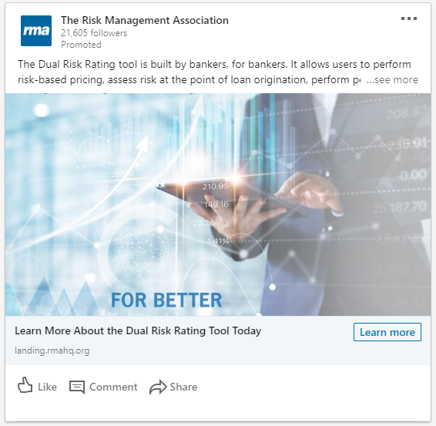
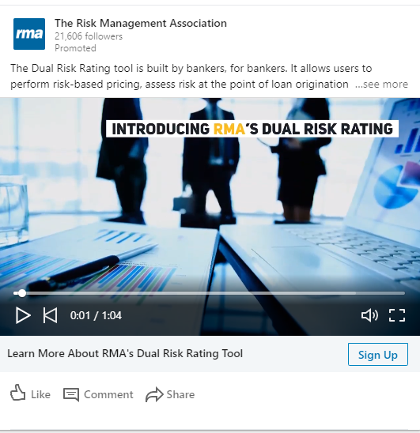
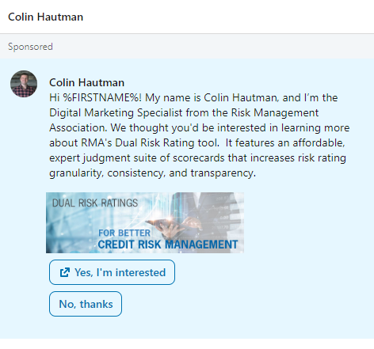
Dual risk rating LinkedIn ad examples
Single Image Ad
Video Ad
Conversation Ad

Slide 9
Proposed Budget
Single Image Ad: ≈ $30 / day (Run for 90 Days = $2700)
Video Ad: ≈ $50 / day (Run for 90 Days = $4500)
Conversation Ad: ≈ $20 / day (Run for 90 Days = $1800)
Recommendation:
  Single Image Ad
  Conversation Ad
  TOTAL: ≈ $4500.00

Slide 10
Statement studies

Slide 11
Statement studies
Goals:
  Raise Awareness
  Convert Leads
  Generate New Business and Revenue
Strategy:
  Focus on Google Search Ads
    Dynamic Search Ads
  Google dynamic search ads allows us to cover all keywords related to the 1-250 industries that we want to target as the ad copy will populate differently based upon users’ search terms
    Ex. “Restaurant Industry Benchmarks” or “Hotel Industry Report”
  Run an all-encompassing dynamic text ad for 90 days and course correct as we see fit

Slide 12
Target audience
Industry: Start with the top 50 industries that have downloaded eSS from RMA to set a baseline of interest
Job Experience Level: Entry & Mid-Level employees at organizations
Job Role: Finance Coordinators, Marketing Strategists, and Account Executives (Sales)

Slide 13
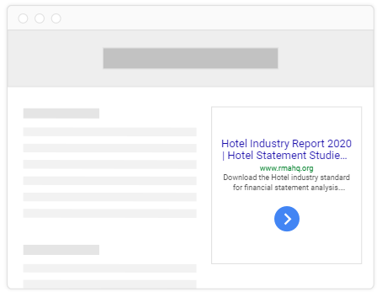
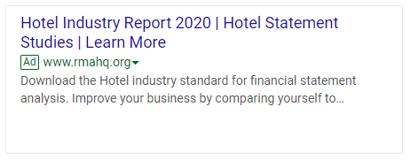
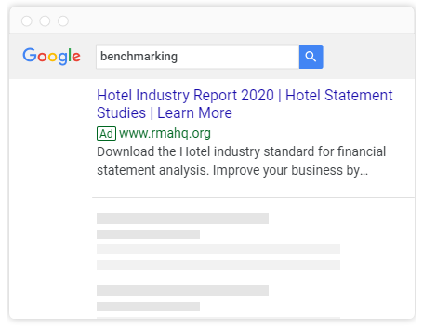
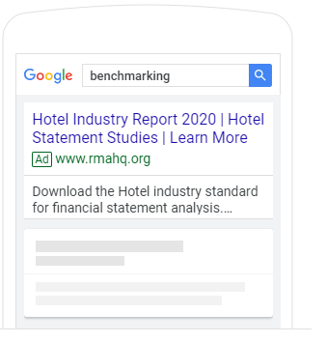
Statement studies Google ad examples
Google Ad Example
Ad on Google Partner Sites
Ad on mobile Google Search
Ad on desktop Google Search

Slide 14
Statement studies landing page example
Under Development

Slide 15
Proposed Budget
Dynamic Search Ad: ≈ $10 / daily average ($900 for 90 days)

Slide 16
Model validation consortium

Slide 17
Model validation consortium
Goals:
  Increase awareness
  Generate inquiries
  Convert inquiries to leads
  Generate 10 new leads a month over 90 days
Strategy:
  Focus on LinkedIn Ads and Google Ads
    Single Image LinkedIn Ad
    Google Search Ad
  LinkedIn ads allows us to hyper-focus on industry and audience
  Google Search Ads allows us to build awareness and target a wide array of banks
  Run a combination of above ads for 90 days and course correct as we see fit

Slide 18
Target audience
Bank Size
Discipline
Job Experience Level
Job Role
Regional Community
Enterprise Risk
Regional
Secondary:
Primary:
Mid-level
Senior
Primary:
Community (as they approach $10B)
CRO
National
Secondary:
Executive
Entry Level
Head of Enterprise Risk Management (ERM)
Head of Model Risk Management (MRM)
Model Risk Analyst

Slide 19
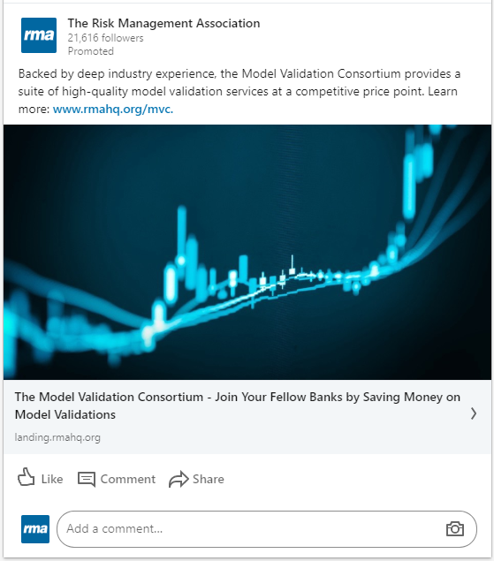
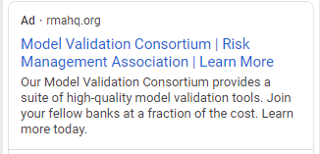
Model validation consortium LinkedIn and google ad examples
Google Ad Example
LinkedIn Ad Example

Slide 20
Model validation consortium landing page example
Under Development

Slide 21
Proposed Budget
LinkedIn Single Image Ad: ≈ $30 / daily budget ($2700 for 90 days)
Google Search Ad: ≈ $12 daily average ($1080 for 90 days)
TOTAL: $3780

Slide 22
overall budget (90 Days)
Dual Risk Rating (Single Image + Conversation Ads): ≈ $4500.00
Statement Studies (Google Dynamic Search Ad): ≈ $900.00
Model Validation Consortium (LinkedIn Ad + Google Ad): ≈ $3780.00
TOTAL: ≈ $9,180

Slide 23
Questions?

